Slide 1

ORBIT & EYE
Dr.K.A.Salvin , MBBS, MD, FRCS

Slide 2
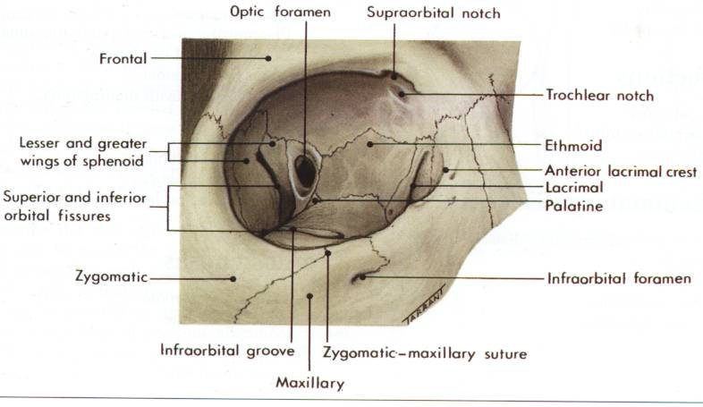
ANATOMY OF ORBIT

Slide 3
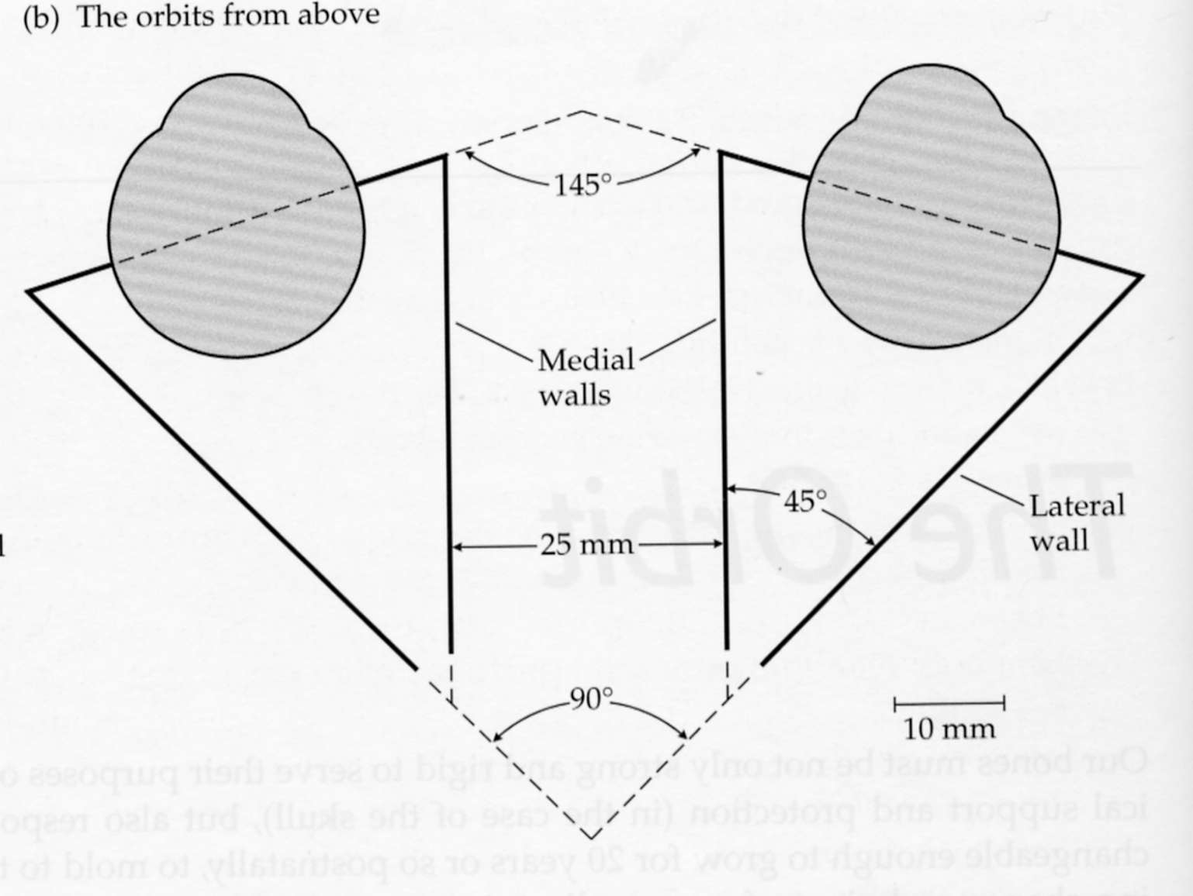
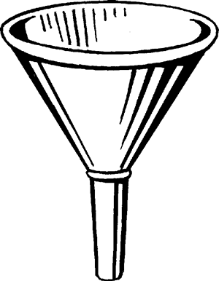
ORBIT
Orbit / eye socket is roughly irregular four sided pyramid located on either side of root of nose.
Base - at the orbital opening
Apex - at optical canal
Axis directed posteriorly
and medially
Medial walls - nearly parallel
Medial and lateral walls
makes an angle of 45 degrees
ORBIT
25mm

Slide 4
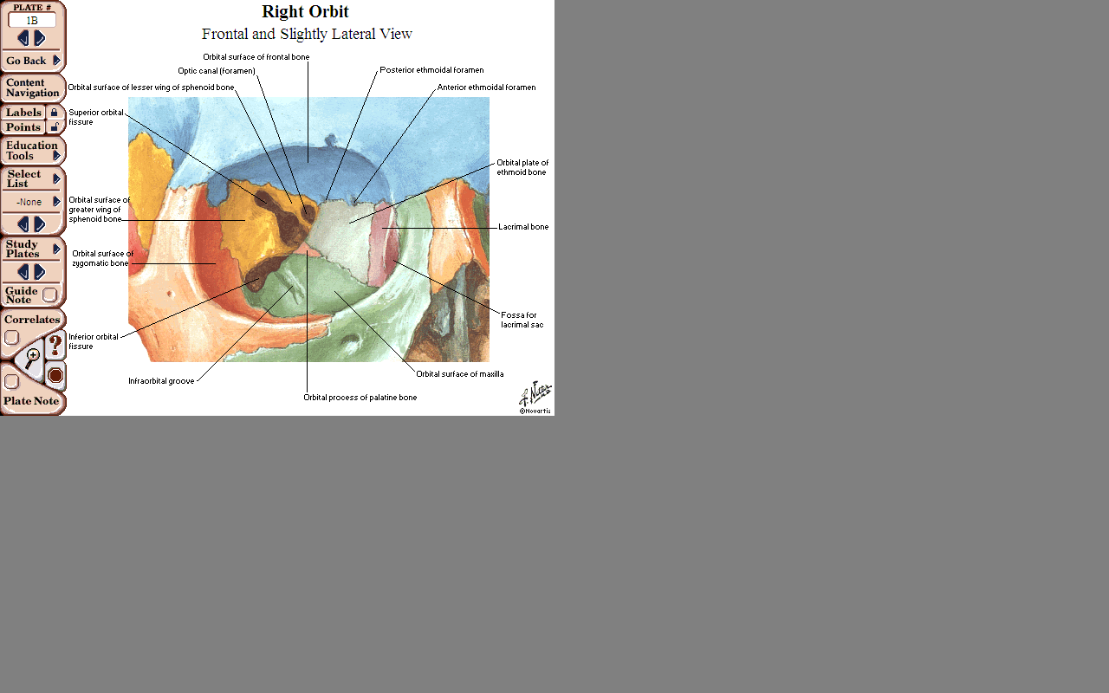
ORBITAL CAVITY
CONTRIBUTED BY 7 BONES
Frontal bone
Zygomatic bone
Maxilla
Ethmoid bone
Sphenoid bone
Lacrimal bone
Palatine bone
ENTRANCE OF THE ORBIT
Frontal, Zygomatic, Maxillary Bones
ORBIT
ORBIT

Slide 5
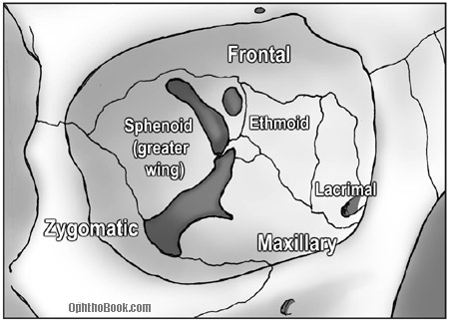
ROOF
ORBIT
Orbital plate of frontal bone
Posteriorly small portion contributed by lesser wing of sphenoid.
Anteriomedially frontal sinus is present in the frontal bone.
Supra orbital foramen is present at junction of medial and middle half.

Slide 6
FLOOR
Orbital plate of maxilla
Anteriolaterally- zygomatic bone
Posteriomedially- orbital process of palatine bone
On the lateral side, anteriorly continues with the lateral wall but separated posteriorly by inferior orbital fissure.
It roofs maxillary sinus
Its thin and is most commonly fractured.
ORBIT

Slide 7
MEDIAL WALL
ORBIT
Orbital plate of ethmoid bone (lamina papyracia)
Anteriorly – lacrimal bone
At the apex – body of sphenoid
Lacrimal bone contains fossa for nasolacrimal sac

Slide 8
L ATERAL WALL
ORBIT
Frontal process of zygomatic bone anteriorly and the orbital surface of greater wing of sphenoid posteriorly.
Thickest wall of the orbit
Orbital tubercle – lateral palpebral ligament
Continuous with roof anteriorly and separated posteriorly by superior orbital fissure

Slide 9
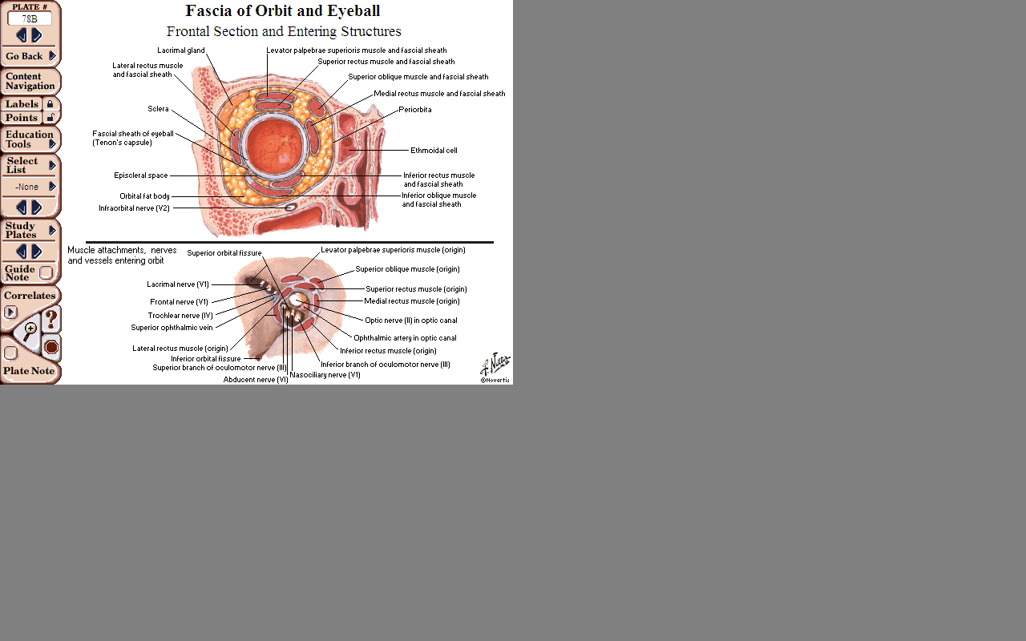
COMMUNICATIONS
OPTIC CANAL
Located between two roots that connect lesser wing of sphenoid with body of sphenoid
Connects orbit and middle cranial fossa
Transmits optic nerve, menengial sheaths, opthalmic artery
ORBITAL CAVITY

Slide 10
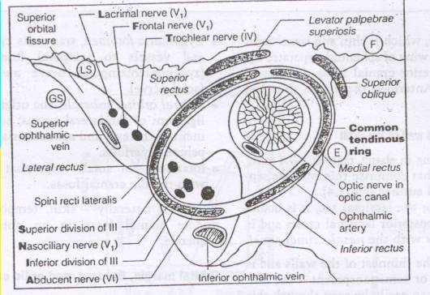
COMMUNICATIONS
SUPERIOR ORBITAL FISSURE
Gap between greater and lesser wings of sphenoid
Connects orbit and cranial cavity
Transmits occulomotor, trochlear, opthalmic, abduscens nerves and opthalmic veins
ORBITAL CAVITY

Slide 11
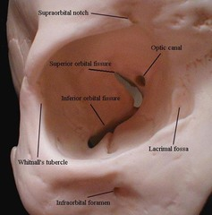
COMMUNICATIONS
INFERIOR ORBITAL FISSURE
Bounded by
Above – greater wing of sphenoid
Below – maxilla
Laterally – zygomatic bone
Connects orbit with pterigopalatine and infratemporal fossa
Transmits infraorbital, zygomatic branches of maxillary nerve and vessels, orbital rami of pterigopalatine ganglion
ORBITAL CAVITY

Slide 12
COMMUNICATIONS
ETHMOIDAL FORAMEN
At the junction of frontal and ethmoid bones, anteriorly and posteriorly
Connects with ethmoid sinuses, anterior cranial fossa, nasal cavity.
Openings for Zygomatico temporal and zygomatico facial nerves
In the lateral wall on zygomatic surface
ORBITAL CAVITY

Slide 13
CONTENTS
Eye ball occupying 1/5th of the orbit
Extra ocular muscles
Optic, Occulomotor, Trochlear, Abduscens, Opthalmic and Maxillary nerves
Ciliary parasympathetic ganglion
Opthalmic vessels
Nasolacrimal apparatus
Orbital fat and connective tissue
ORBITAL CAVITY

Slide 14
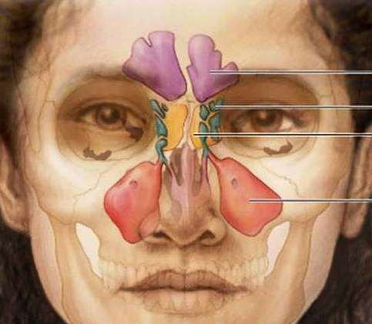
NOSE AND PARANASAL SINUSES

Slide 15

CONTENTS
INTRODUCTION
ANATOMY
BLOOD SUPPLY
NERVE SUPPLY
LYMPHATIC DRAINAGE
RADIOGRAPHIC VIEWS

Slide 16




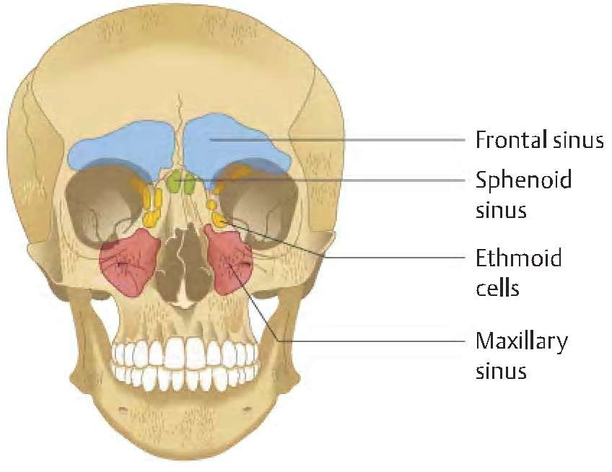
INTRODUCTION

Slide 17
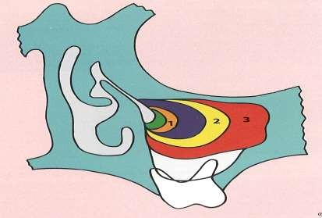
Maxillary sinus - first to be developed and aerated at birth.
shows biphasic growth. The first growth phase during the first three years of life, and the next growth phase occur between 7 – 18 years.
Initially located medial to the orbit, later sinus extends laterally & Inferiorly.
Floor of sinus does not extend below the level of
1=newborn, 2=12 yrs 3=adult
nasal cavity until the eruption of permenant teeth.

Slide 18
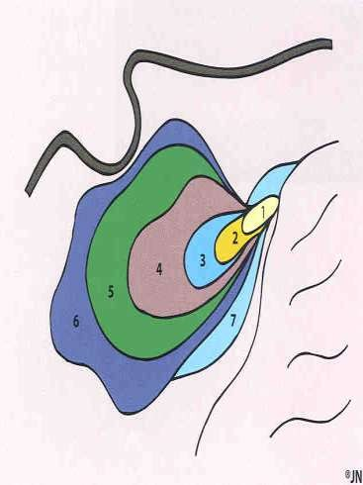
Sphenoidal sinus is undevoleped and non-aereated at birth.
Aeration begins at age 3years and then progresses posteriorly.
sphenoid: 1=newborn, 2=3yo,
3=5yo, 4=7yo, 5=12yo, 6=adult,

Slide 19
Ethmoid air cells-develop during puberty and develop slowly until approximately 17-18 years of age.
Pneumatization of this sinus begins during the 4th year of childhood and gets completed by the 17th year of life

Slide 20
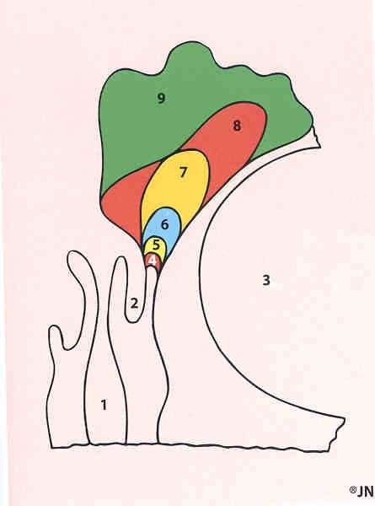
Frontal sinus is last sinus to develop ,as a direct continuation or by upward migration of anterior ethmoidal air cells.
Remains as a small blind sac within the frontal bone till 2 years of age,from 2 to 9 years secondary pneumatization of frontal bone proceeds.
frontal: 4=newborn, 5=1yo, 6=4yo, 7=7yo,9=adult

Slide 21


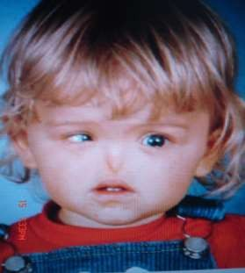
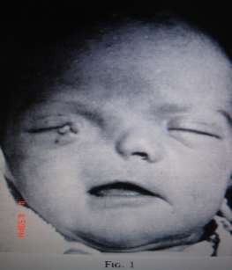
CONGENITAL ANOMALIES OF THE NOSE
ARHINIA
due to bilateral absence of nasal placodes
HALF NOSE
due to unilateral absence of nasal placode

Slide 22

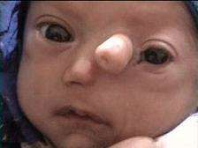
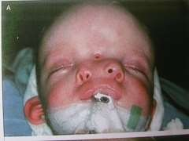
CONGENITAL ANOMALIES OF THE NOSE
PROBOSCIS LATERALIS
due to imperfect fusion between the maxillary process and the lateral nasal process.
POLYRRHINIA
duplication of the medial
nasal processes.

Slide 23


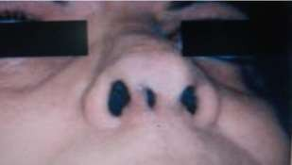
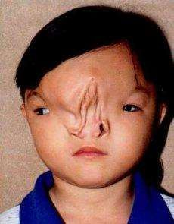
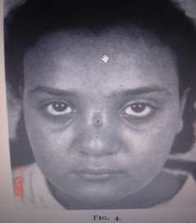
CONGENITAL ANOMALIES OF THE NOSE
SUPERNUMERARY NOSTRIL
MIDLINE NASAL SINUS:
incomplete fusion of the right and left medial nasal prominence
NASAL CLEFTS :
failure of the frontal nasal process to develop appropriately results into two separated halves of the nose.

Slide 24


FUNCTIONS OF
NOSE & PARANASAL SINUSES
To breath
Olfaction
To filter the air
To taste
Humidifying and warming inspired air
Increasing surface area for olfaction
Lightening the skull
Resonance
Absorbing shock
Contribute to facial growth

Slide 25



ANATOMY OF NOSE & PARANASAL
SINUSES

Slide 26

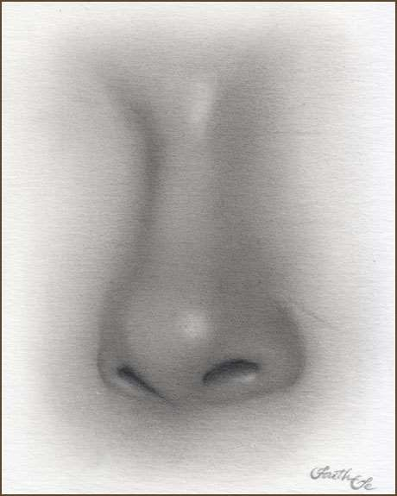
EXTERNAL NOSE
Radix/root of nose Bridge
Nasofacial angle
Dorsum
Alar nasal angle Pronasale (tip)
Ala nasi (nasal wings) columella
Anterior nares /nostrils

Slide 27


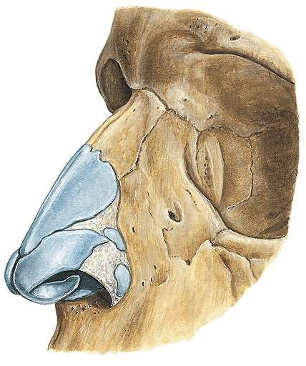
EXTERNAL NOSE
Upper 1/3 rd (nasion region)
Middle 1/3 rd
Lower 1/3 rd

Slide 28






BONY PARTS
Nasal processes of
the frontal bones
Nasal bones Frontal process
of the maxillae

Slide 29


CARTILAGINOUS PARTS
Lateral nasal
cartilage
Greater alar cartilage
Dense connective
tissue
Lesser alar cartilage

Slide 30

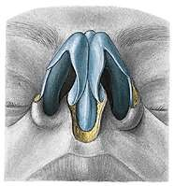
BASAL VEIW
Middle crus Lateral crus Medial crus

Slide 31


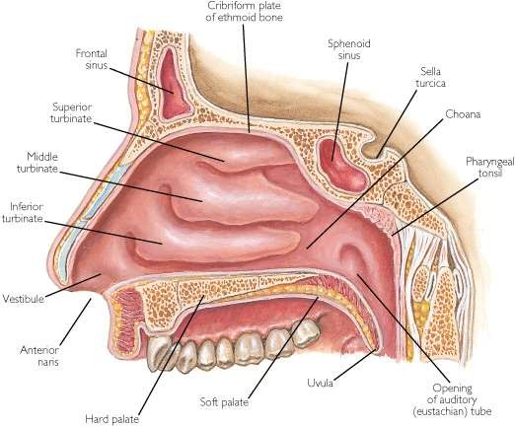
NASAL CAVITY
Extends from nostrils to posterior nasal

Slide 32

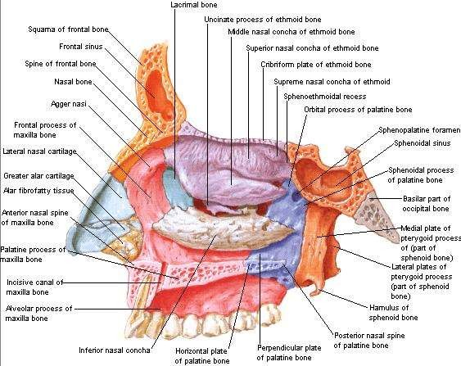
WALLS OF NASAL CAVITY
Roof
Floor
Medial/septal wall
Lateral wall

Slide 33

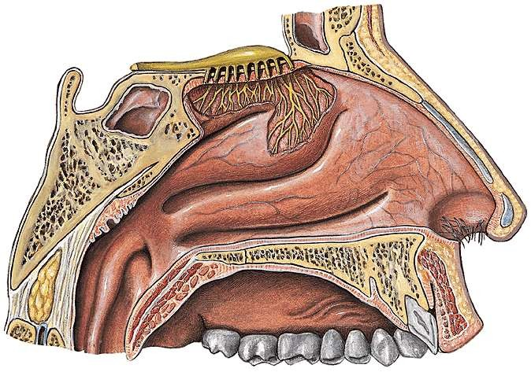
ROOF OF NASAL CAVITY
Frontal & nasal bones
Cribriform plate of
ethmoid
Body of
sphenoid

Slide 34

The Floor of Nasal Cavity
Horizontal plate of palatine bone
Palatine process of maxilla

Slide 35


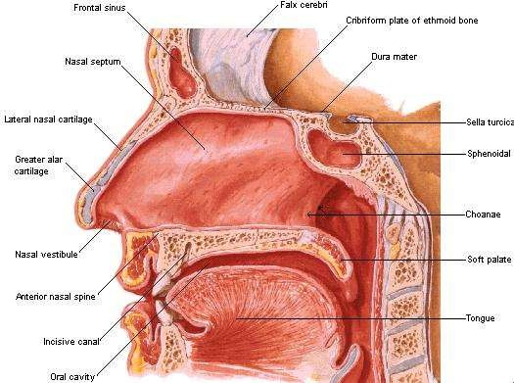


MEDIAL WALL
Divides nasal cavity into two halves.
Seldom lies in midline
Vestibule of
nose

Slide 36

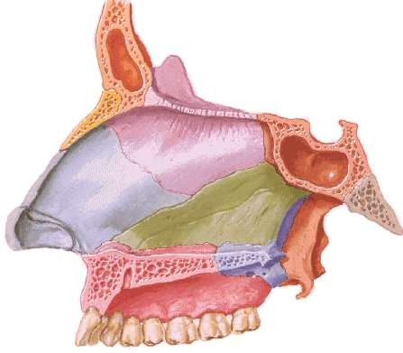
NASAL SEPTUM
Vertical plate of ethmoid
Septal cartilage vomer

Slide 37

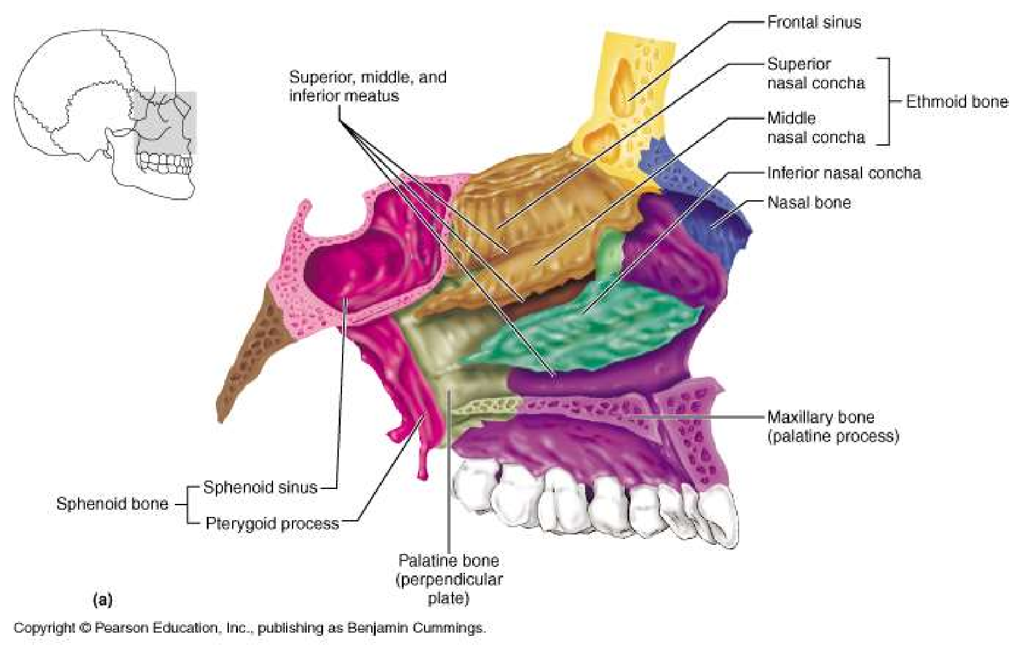
LATERAL WALL

Slide 38
Lateral wall – nasal cavity
Lateral wall – maxilla -which has a large defect in its medial side.
Several bones contribute to close this deffect. Therefore, they form a part of the lateral wall of the nasal cavity

Slide 39
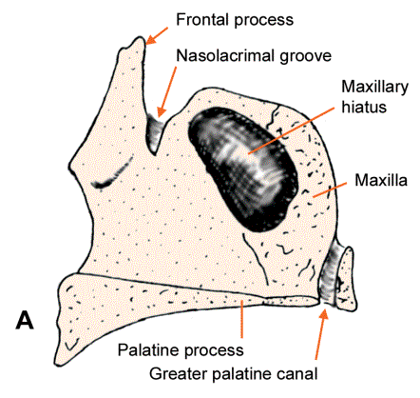
Lateral wall – nasal cavity..
The base of the lateral wall formed by the maxilla.

Slide 40
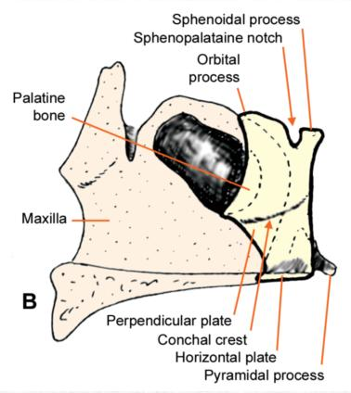
Lateral wall – nasal cavity...
Palatine bone overlaps the posterior part of the maxilla

Slide 41
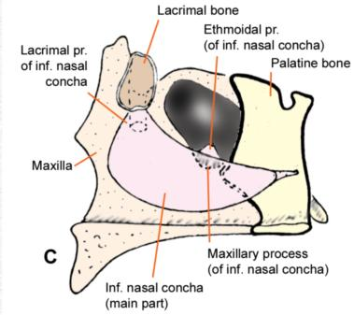
Lateral wall – nasal cavity....
The lacrimal bone and the inferior nasal concha are placed over the maxilla and the palatine bone.

Slide 42
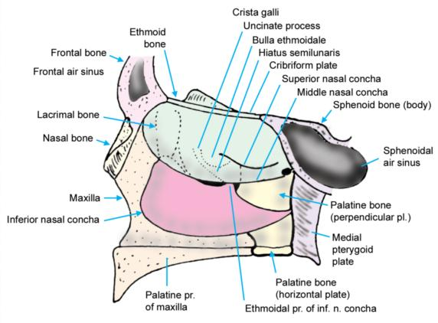
Lateral wall of the nasal cavity is completed by the ethmoid bone. The parts shown in dotted line can be seen only when the middle concha is lifted off. Compare with

Slide 43
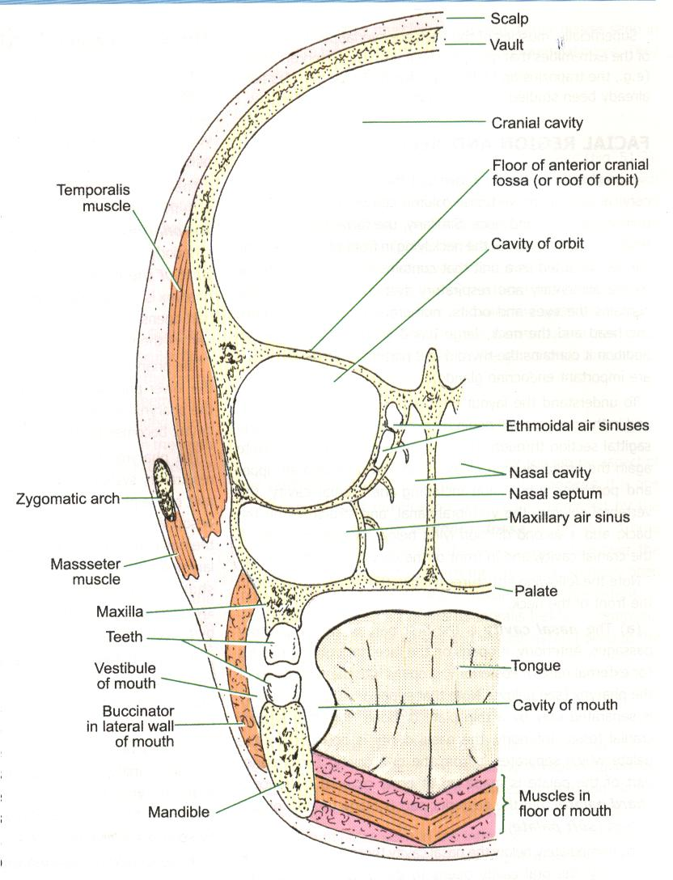

Slide 44
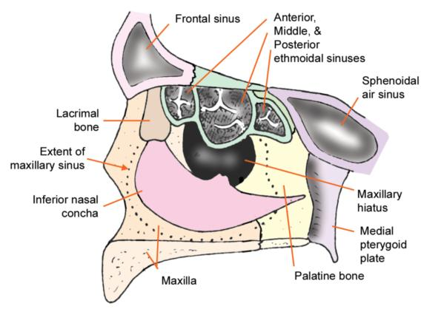

Slide 45
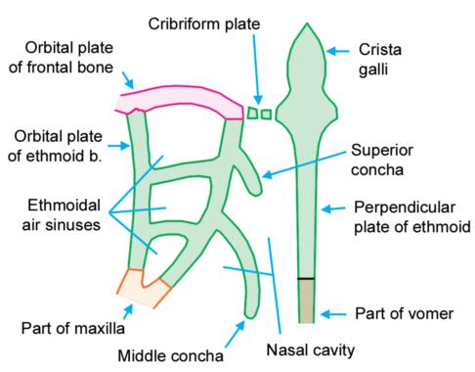

Slide 46

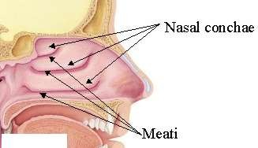
LATERAL WALL OF NOSE
Marked by 3 projections:
Superior concha
Middle concha
Inferior concha
The space below each concha is called a meatus.

Slide 47

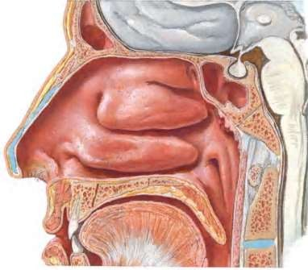
SUPERIOR MEATUS
Space below the superior concha.
Superior concha is a process of ethmoid bone.
Smallest of all meatus.
Posterior ethmoidal
sinuses opens into it.
Sphenoethmoidal recess is space above superior concha.
Sphenoidal sinus opens into it.

Slide 48

MIDDLE MEATUS
Space below middle concha.
Middle concha is the medial process of ethmoidal labrynth.
Hiatus semilunaris (curved opening)
-frontal & maxillary sinuses
Bulla ethmoidalis
(rounded opening)
-middle ethmoidal air cells.

Slide 49

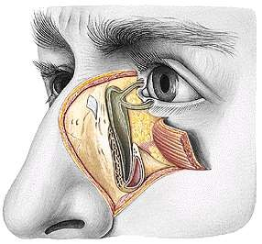
INFERIOR MEATUS
Largest of the meatuses.
Space below the inferior concha.
Inferior concha is thin, curved ,independent bone.
Naso lacrimal duct opens in the anterior part.

Slide 50

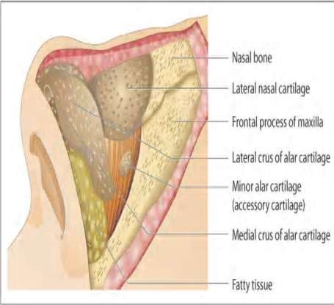
SKIN OVER THE NOSE
 Skin is mobile over upper thirds but firmly adherent in the lower part to cartilages.

Slide 51

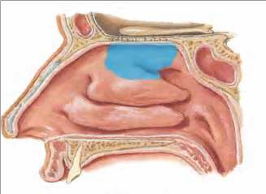
MUCOUS MEMBRANE
Upper 1/3 rd –olfactory region, mucous membrane- more delicate and yellowish.
Lower 2/3 rd – Respiratory region, Lined by pseudo stratified ciliated columnar epithelium, mucoperiosteum-Thick ,spongy
,highly vascular with numerous mucous glands.
Mucous membrane covering vestibule of nose carries stiff hairs / vibrissae.
Contains Arteriovenous anastamosis
–warms the air passing through it.

Slide 52

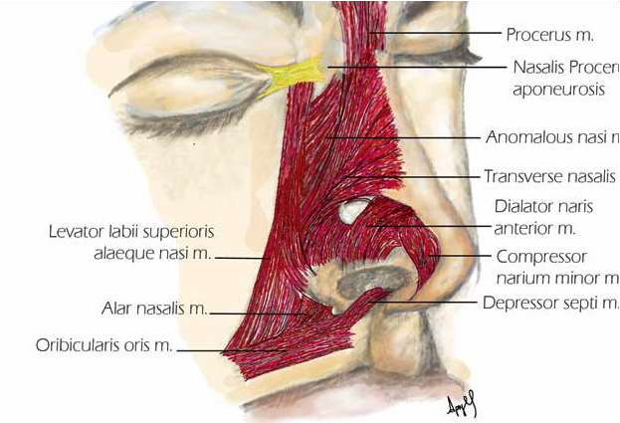
MUSCLES OF THE NOSE

Slide 53

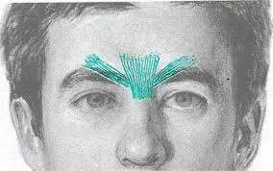
MUSCLES OF THE NOSE
PROCERUS:
most cephalic muscle of the nose, pyramidal shaped.
Origin –facial
aponeurosis.
Insertion –from glabellar area.
Assists in dilatation of
the nares.

Slide 54
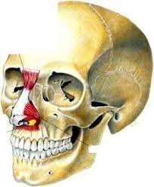
 NASALIS:
It has 2 components:
(1)transverse nasalis /compressor nasi: the muscle spans the dorsu of the nose, covering the
lateral cartilages.
ORIGIN :maxilla above and lateral to incisive fossa.
INSERTION: with its counterpart and procerus & levator labi superioris aeque nasi muscle.
(2) the pars alaris (alar nasalis).
ORIGIN: above lateral and canine.(more lateral & slightly caudal to the bony origin of the depressor septi nasi muscles).
INSERTION : into ala above lateral crus of the lower lateral cartilage
m
upper

Slide 55
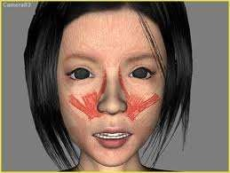
Levator labii superioris alaequae nasi
Origin: upper part of frontal process of maxilla.
It extends lateral to the nose in a cephalocaudal direction and has ﬁbers that are attached to the nostril, contributing to the dilatation of the nares.
Insetion:lateral crus of major alar cartilage and lateral part of upper lip.
Release of the muscles will dilate the nostrils,

Slide 56
Dilator naris anterior
Depressor septi
Arises from the maxilla (just below the nasal spine), sometimes fuses with some ﬁbers of the orbicularis oris muscle.
Inserted along the columella, medial crus of alar cartilage.
Small muscle
Origin:ULC and alar part
of nasalis.
Encircles nares
Primary dilator of nose
Depressor alae or myrtiforme.
originates from the border of the pyriform crest and then rises vertically, like a fan, up to the ala, acting as a depressor and constrictor of the nostrils.

Slide 57

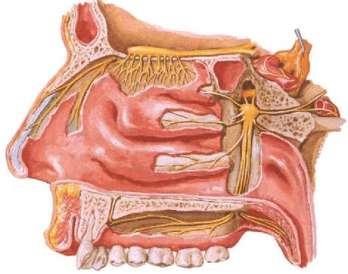
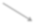
NERVE SUPPLY
External nose –Infra orbital nerve, Infra trochlear, External nasal nerve.
Olfactory neves
Anterior ethmoidal nerve
Nasal branches of pterigo palatine ganglion
Nasopalatine nerve

Slide 58
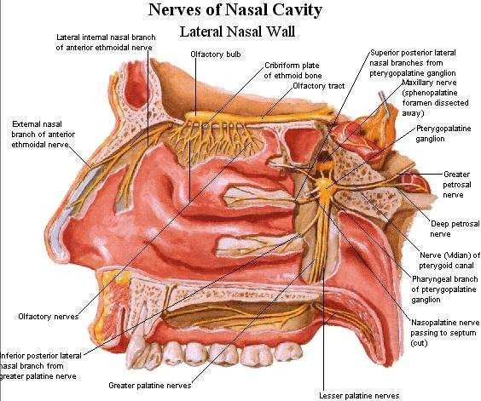

Slide 59

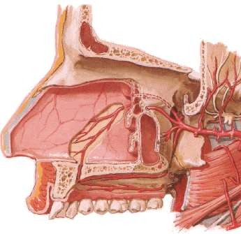
BLOOD SUPPLY
EXTERNAL NOSE:
Dorsal nasal artery
Angular artery
Superior labial artery
INTERNAL NOSE:
Anterior & posterior ethmoidal
arteries
Sphenopalatine artery
Superior labial artery
Infraorbital and superior dental
arteries
Pharyngeal branch of maxillary artery
Greater palatine artery

Slide 60

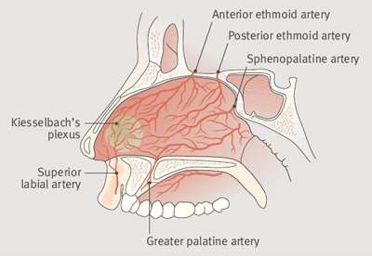
KESSELBACHS PLEXUS
These arteries are
(mnemonic –LEGS)
Superior Labial
Anterior Ethmoidal
Greater palatine
Sphenopalatine
Little's area, is a region in the anteroinferior part of the nasal septum, where there is confluence of 4 arteries forming this plexus.

Slide 61


LYMPHATIC DRAINAGE
Submandibular lymphnodes: from the external nose and anterior part of the nasal cavity.
Upper deep cervical nodes: drain the rest of the nasal cavity, either directly or through the retropharyngeal nodes.

Slide 62

SINUSES
PARANASAL

Slide 63



MAXILLARY SINUS
Antrum of Highmore.
largest of all paranasal sinuses
Pyramidal shaped , Lying just under the cheek.
Capacity of 30ml.

Slide 64


Anterior wall (anterolateral wall)–lateral wall of the
maxilla (canine fossa).
Posterior wall – temporal surface of maxilla.
Roof – floor of the orbit(infraorbital vessels and nerve).
Floor – alveolar process of maxilla & hard palate.
Medial wall (base of maxillary sinus)- lateral wall of the nasal cavity.
Laterally (apex of sinus) – zygomatic bone

Slide 65


OSTIUM OF MAXILLARY SINUS
Opens in the Posteroinferior end of hiatus semilunaris.
Close to roof of sinus.
Unfavorable for drainage of sinus.
In children the floor lies at or above the level of the floor of the nasal fossa.
In adults it lies about 1.25cm below the floor of the nasal fossa

Slide 66


SPHENOIDAL SINUS
Lie within the body of the sphenoid bone
Below sella turcica (extends between dorsum sellae and post clinoid processes)
The average capacity is 7ml.

Slide 67















RELATIONS OF SPHENOIDAL SIN
Superiorly fossa)
– Pituitary gland (hypophysial Lateral wall – Optic
nerve and internal carotid
artery
Floor – Nerve of pterygoid canal

Slide 68



OPENING OF SPHENOID SINUS
Opens into the sphenoethmoidal recess above the superior concha.
Ostium -Size (0.5-4mm)

Slide 69


ETHMOIDAL SINUS
They are anterior, middle, and posterior.
They are contained within the ethmoid bone, between the nose and the orbit.
Anterior & middle drains into middle nasal meatus
Posterior drain into superior nasal meatus

Slide 70


FRONTAL SINUS
Second largest sinuses
2 – 2.5 cm
Rarely symmetrical
Contained within the frontal bone .
Separated from each
other by a bony septum.
Each sinus is roughly triangular
Extending upward above the medial end of the eyebrow and backward into the medial part of the roof of the orbit.

Slide 71


FRONTONASAL DUCT
Opens into the middle meatus
The average capacity is about 7 ml in the adult. True frontonasal duct only in 15% of people.

Slide 72


DRAINAGE OF SINUSES

Slide 73


OSTEOMEATAL COMPLEX
This is the area bounded by the middle turbiante medially, the lamina papyracea laterally, and the basal lamella superiorly and posteriorly. The inferior and anterior borders of the osteomeatal complex are open.
This is in fact a narrow anatomical
region consisting of :
Multiple bony structures (Middle turbinate, uncinate process, Bulla ethmoidalis)
Air spaces (Frontal recess, ethmoidal infundibulum, middle meatus)
Ostia of anterior ethmoidal, maxillary and frontal sinuses.

Slide 74




APPLIED ASPECTS

Slide 75



LATERAL PROJECTION
ALL FACIAL BONES

Slide 76



CALDWELL / PA AXIAL
FRONTAL SINUS ANT. ETHMOIDAL SINUS

Slide 77



WATERS
MAXILLARY SINUSES ORBITS MAXILLA ZYGOMA

Slide 78



OPEN MOUTH WATERS
SPHENOID SINUS
MAXILLARY SINUS

Slide 79



SUB MENTO VERTEX
ETHMOIDAL SINUSES SPHENOIDAL SINUSES NASAL SEPTUM ZYGOMATIC ARCHS

Slide 80


C T SCAN
MAXILLARY SINUS
SPHENOIDAL
SINUS

